Slide 1
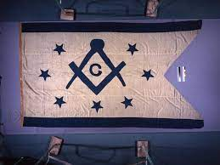

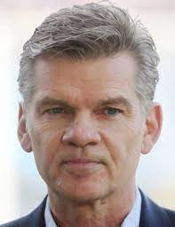
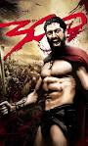
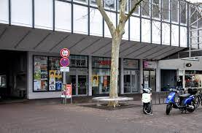
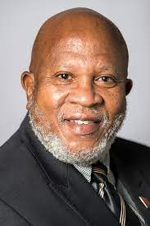
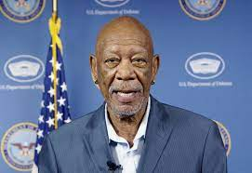
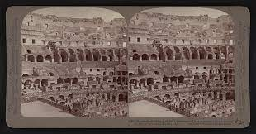
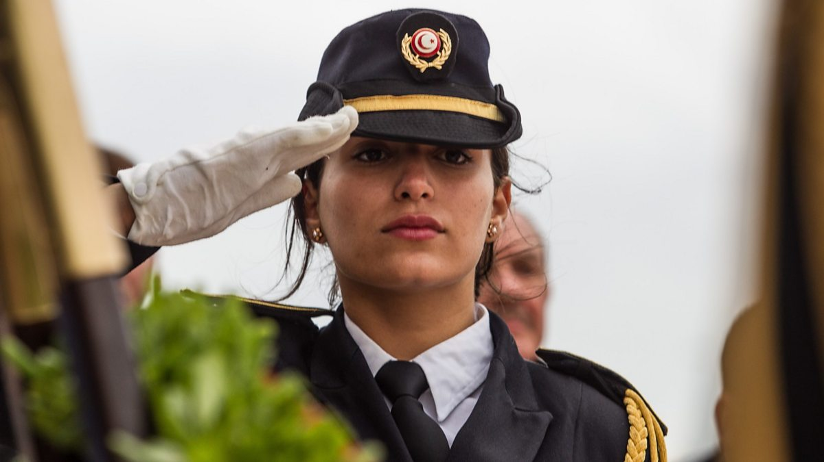


FBI
Develoment
CHECKPIN CHALRIE(SQ[].CPVA gheoh(“kinderdisko”)
WWI.marx(kaiserpassage)
GOSPEL
1999
HOMICIE:TRANVESTITE
HOMCI:JESUS
2014
WWI.marx
1998

Slide 2



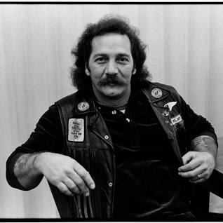
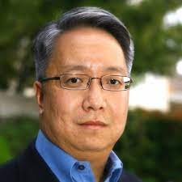
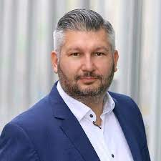
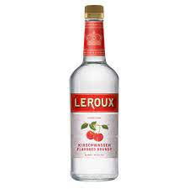


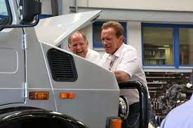
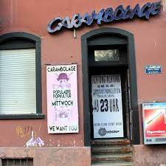
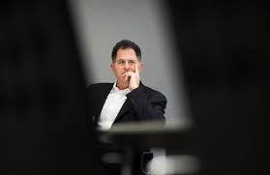
FBI
Develoment
FACEBOOK
PETER
TIMOTHY
Circiling House
with infant
VIRIGNA.Jason peterson
WWI.MAINSTREEET
nonPoliceConten Item
G.VIRIGNA
CPVA.
.CHERYTWATER
nonPoliceConten Item
G.VIRIGNA
CPVA.
.CHERYTWATER
1998 & 2015 g.roth.ibm.dmierl.apple

Slide 3
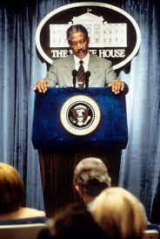
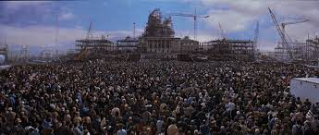
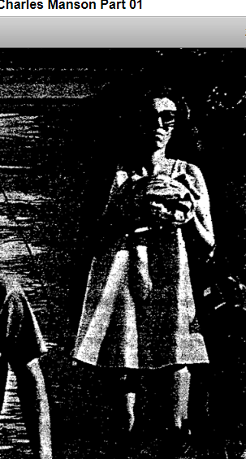
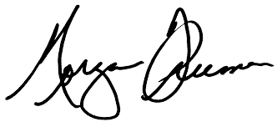
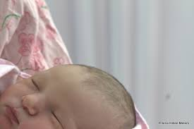
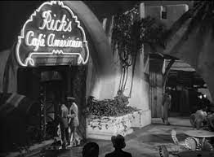
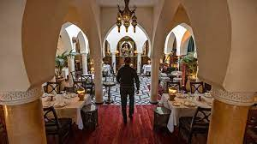
FBI
Develoment
SQ.CDCR.CPVA.§187.PREA
25Y
V2.FBI:KIDNANPING
casablanca movie tunisa pub
[x] no

Slide 4

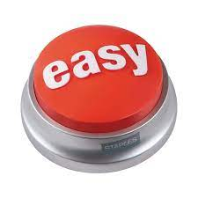

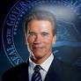
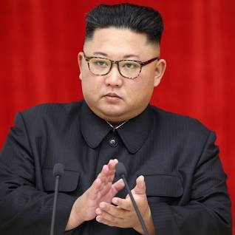

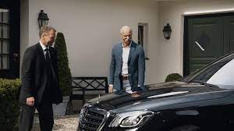
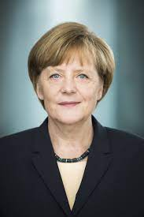
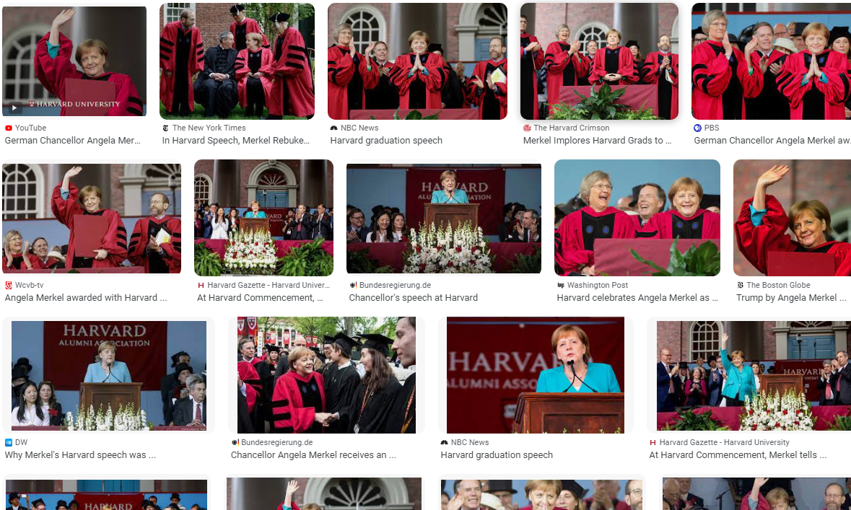

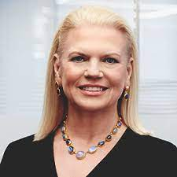


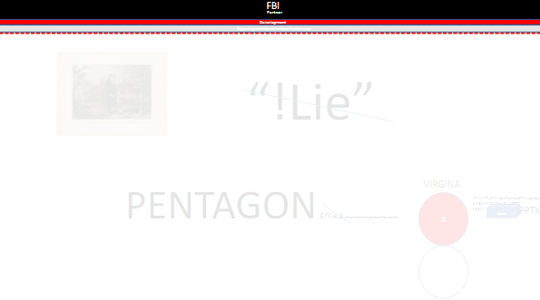
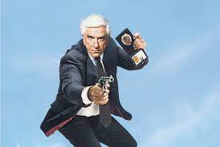

FBI
Develoment
0.0001
ATOMICLOCK
2015 Decmber
FBI:TERRORISM
Jason Petersson
V2.FBI:KIDNANPING
KOCHEMAN
G
2013 July
MARK(lelise).41
high school winnipeg, minnesota

Slide 5
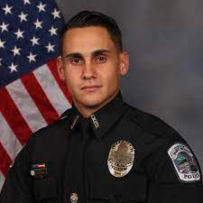
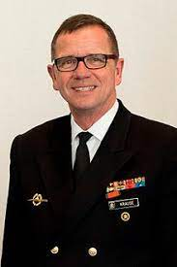
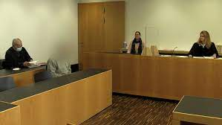
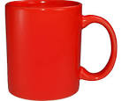
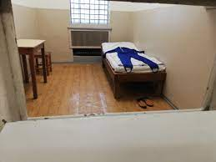
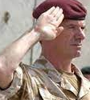
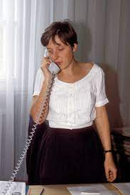
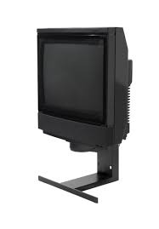
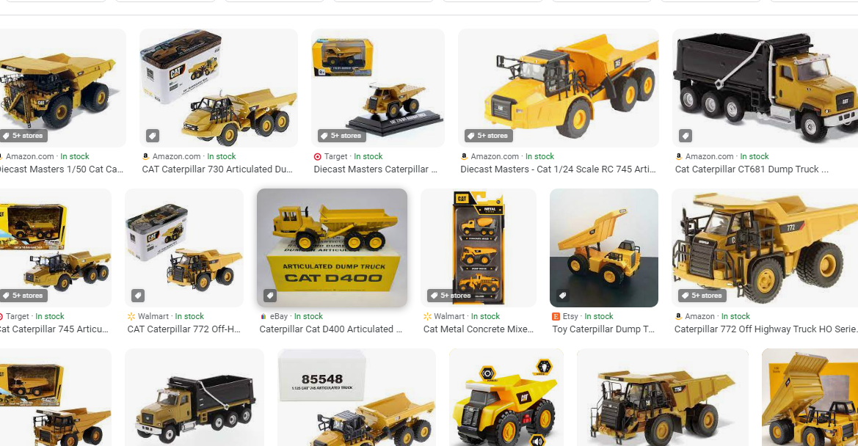
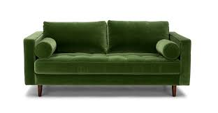

FBI
Develoment
JFK(Holger)
SYMPHONEY
1998
I quit
CHECKPITNXALR(§Theft)
§Sickday
St. Francic.marx(France amoroso)
Insurance Sales Professional
1Y Germany Army
2W
Improper Army Solute
https://www.fbi.gov/investigate/counterintelligence/major-cases
1988/9
FRANKFURTER STR, HEUSENSTAM !voted thomas-is-dieter
ENTRY: CAT(DEERE)
ENTRY: !jew: Simens.Biomation.Gould
EXTI: (DEERE)
EXIT: CAT(DEERE)
BLUE: gas Danfoss(gas) Jutta Coelln, rene breuer
ATOMCLOICK.41(FRIEND,rene,babelsber frendship).VIRGIN.friends
J-10
1988/90
angela
1990/1
HUDSON
IPX aTOMCLICK(HOCM:BORIS.HOMICE:LUX.paticia)
&
1988
/1992
Sand: stephanie LARRY.MIAMI
sand
HEUSTAMMERALLE
1983/4-1992 CHECKPOINT CHARLIE(Anika Breur/ Anita; angela merkel)
Toys[] Tyson,rene
WWI.JOEL

Slide 6
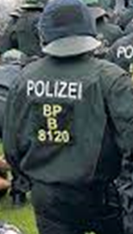
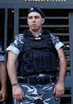

FBI
Develoment
HOMICDIE:SUNSTORK(Kodak, Rene Brueer, Salem ?< Jason Meiers)
1998
MAINSTREEET
TORT-1
G.VIRIGNA.MARY
INT.CHECIK POITN CHARLIE(frindshipt,rene)
Salem[1]
SQ.AIRFIELDGhoeh(seitz) footlocker

Slide 7

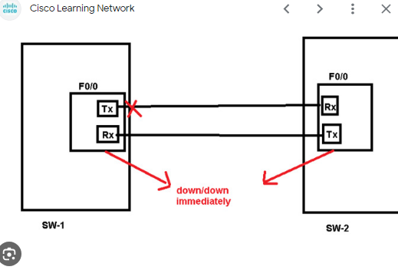
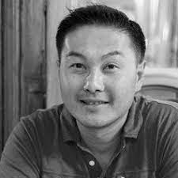
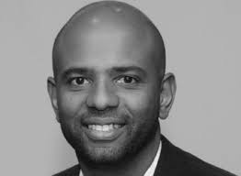
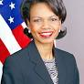
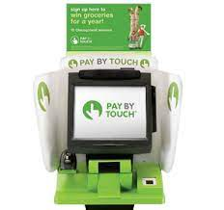
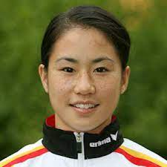
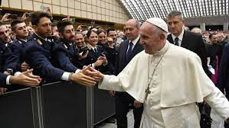
FBI
Develoment
2005/6 CREDIT: Kim Bui Crazy Hourse , Crazy Talk (GMAC CREDIT ibm.proflicis)
MATHEW
SQ.CDCR.CPVA.§187.PREA
25Y
CHART
!AVAIBLITY.PREISNET.
!G.VIRIGNA.CPVA
TIMOTHY
V2:FBI:KIDNAPPING (keep-alive).phil.appletouch.networking
DEA(cocint) mr rogers
Phil/kim MINSOTTA arrest
UN: G.MAPS-> 1994(G.fiat->LV,SF-)
Reprot to gobhohe(white:micehal lukanvich)
Rpeort from gheoho(black: michel king)
LEVEL
SECTARRY Son kit !STANFORD
Note:
FRANCICO
000.tw.pns.“Cicso Kid”.St. Andrew
V2.FBI:KIDNANPING
HOMICE:LUX:VIOLA:GYNASITCS

Slide 8








FBI
Develoment
WORK CAMP
HOMCE:LUX:LV ibm innovant 2005
Walking IBM SWAT(MAINSTREET)
PETER
§CREDIT
We should !go in ther
2006 crazy talk
Don’t go in there.
“x/y timing”
Look it the crazy houre
We probely wond go in there.
In Maring two women with accenter(twang) crazy talk, that’s crazy talk. With mathewl langley
SALES
Siebel Database
CLIENT: Siebel Systems
“Randy z/o”
“Randy !In”
20078 SQ St Francis,Thomas-is-dietert(nees)
Stanford
Road trip
SQ
Macdonia
Visitors MLK(gheoh(KING),MATHEW[], timoty(gary)
nonPoliceDA~.angela
&
Avg: Person overrides IBM or ENTERPISE.DEFAUT.nonPoliceQOS.anglea in San Queint(SQ).LARKSPUR
2006
SFO-FRA
2007
SFO-FRA
2017
SFO-FRA
INTERUPTS
2011
SFO-FRA

Slide 9








FBI
Develoment
london caselte near big ben entryance secuity
KING ROVELSE
ARTHUR
Ar-tur, Umimog
Thomas-is-dieter:wyland
PENTAGON.emea
41.nonPolciIntuepsLogical (VIRGINA.roth.ibm.damiler.*)
TIMOTHY
2008 SQ
2014 HOMCI:SPY (breuer, CAT !DEERE)
?HOMCIDI:PETERSSON
KOCHEMAN
2017 IPX:HOMICDIE:UR_UR_OPI
Kit.assited susicide
[x] no
Black room roof
HOMCIE:JEUSE.avg.lsint(susicide) dr dieter zechete

Slide 10
FBI
Develoment
CHART
!G.VIRIGNA.CPVA
UN: G.MAPS-> 1994(G->2005LV,SF-)
(delta)
- dumps
7am-8pm
IMPORT ibm.visa G.MAINSTEET(LV)
G.
ITIL

Slide 11


FBI
Develoment
G.VIRIGN.WHITEHOUSE.Gov. Sch.TRUCK sayah”Singer” changal
fahter
2023 FORT MYERS, FORT WORTH POLICE
000.tw.pns
Karl-Lewis
Truewoth Place
1998 MAINSTREET
HOMICEI:AUSLAENDER:HOMCIE:BILL:WAR IN YUGLSAVIA
Father left

Slide 12




FBI
Develoment
G.WWI.MAINSTREET.WHITEHOUSE MLK(casa blanca, tunis.WW2)
PUB David vs. Goliath
PENTAGON.PAUL.BASE.PUB
41 report to JFK(whtie,.gheo(lukancivi)
41.Reprot from MLK(black.ghoeho(KING)
Apple.touch.hells angels paments
!G.MAINSTREEET

Slide 13


FBI
Develoment

Slide 14











FBI
Develoment
CHECKPOINT CHARILE
WWI:HOMICIDE:KYRSTAL
?HOMCIDE:MATHEW
JOEL
!HOMCIE:JESUE:♥LACE
!HOMCE:MAYRO
Blond fellow:
“tootsie”
SAYLOR.Ghoeh(Tyson)
Freship.angela.renee
Benjamin benny salem HOMICDIE:MAYOR

Slide 15










FBI
Develoment
MAINSTREEET(41.G.VIRIGN.MARY) as she thre the mayor(HOCMEI:MAYER(johs)) out and put the chrilden in the mayors office
1994 Tudesishi
IPX 1999 terasa
Ritat wright, alen MR PERFECT
WAR IN YUGLSAVIA
JOEL
Benjamin benny salem HOMICDIE:MAYOR
JESUE:♥LACE
HOMCEI:JEUSE
HOICM:JEUSE(cherist nees)
HCOEIM:jeuese.VIRGIn.MARY(chriisantian)
Thin guy standing next to you wo could pung and kill you antyim like a bulldog

Slide 16







FBI
Develoment
Monday – Turnday 7am Court Libarayr
Monday – Turnday 5-8pm Court Libarayr
Friday 7am Corut Libra
Satrue 6am Chruch, 8am library
Sunday 6am chrch – 6pm, park 8pm
I quit.
Tivoli

Slide 17













FBI
Develoment
1988
!G.PETER & PAUL
2005
2013 SENDER(CPVA)
1999
STANFORD.VIRGINA.MARY
2014
CPVA.WWI.PRE
2014 INTERCPETOR(CPVA)
2000
2014
CPVA.WWI.PRE
CHECKPOCIN CHARLIE(Marco,300)
2016
2023

Slide 18







FBI
Develoment
RHEIN-MAIN
VIRGIGNA.anglea.HOMICIDE:LUX.elke.restaruants.
1990
Kempinski
Thomas-is-dieter
Thomas-is-dieter
KOCHEMAN.phone.AND.1984.COMMERICAL
!§187.PREA
2019
Thomas-is-dieter
AUSCHWITZ
Thomas-is-dieter
San Mario
Scholoss Hetel - Cabornaa KING.QUEEN.WORM
Collosuiem
MARK(US)
1994
IMPORT Gov.Schw.damiler.twins(giovanne,piatodoro)

